Slide 1
Deep learning,
A to D
PRACTICE DL · OCT 2026
CNNs, NLP, a live app and reinforcement learning. Everything here ran on my MacBook, on real data, and I compared every model with a baseline.
A · images
B · text
C · deploy
D · RL
Notes:
This is my second practice project. The first one was real-time ML on BTC prices. This time I did four deep learning topics one at a time, ran each script myself, and wrote down what happened, including the things that broke.

Slide 2
Four topics, one step at a time
THE PLAN
A
B
C
D
Images
Text
Deploy
RL
CNN from scratch on CIFAR-10, then a pretrained ResNet18
IMDB reviews: bag of words, embeddings + LSTM, DistilBERT
My BTC up/down model as a live Streamlit web app
Q-learning on FrozenLake and Taxi, DQN on CartPole
My rule for every step: always run a simple baseline next to the model, so I know whether it actually learned something.
Setup: MacBook (M-series GPU via PyTorch MPS), Python 3.12, VS Code · practice dl · 02
Notes:
Free data only, no API keys. Each script has a --quick mode I ran first to check it works before the full run.

Slide 3
Fewer weights, way better results
A1 · CNN FROM SCRATCH · CIFAR-10
model | test acc | weights
just guessing | 10.0% | –
linear (pixels) | 40.1% | 30,730
MLP | 51.7% | 1,707,274
CNN | 88.0% | 289,194
The CNN has about 6x fewer weights than the MLP and still beats it by 36 points. Sliding the same small filters over the whole picture beats giving every pixel its own weight.
Hardest class: cat (74%), mostly mixed up with dog. Car/truck and plane/ship too.
10k test photos never seen in training · 15 epochs, ~5 s each on the Mac GPU · practice dl · 03
Notes:
Augmentation (random flips and shifts) kept train and val close: 89.5% vs 88.6%, so it barely overfit.

Slide 4
Pretraining was worth 20x more photos
A2 · TRANSFER LEARNING · PRETRAINED RESNET18
model | trained on | test acc
A1 CNN from scratch | 45k | 88.0%
frozen ResNet + new last layer | 45k | 85.9%
finetuned ResNet (3 epochs) | 45k | 95.2%
CNN from scratch | 2k | 67.0%
finetuned ResNet | 2k | 87.8%
2k ≈ 45k
With only 2,000 photos the pretrained ResNet matched my CNN trained on all 45,000. It already learned what edges and shapes look like from ImageNet.
Images resized 32 → 128 px for ResNet · finetune ~51 s per epoch on the Mac GPU · practice dl · 04
Notes:
The finetuned ResNet on 2k got 100% train accuracy but 88% val, so it memorised the training set. It still generalised way better than training from scratch.

Slide 5
Word counts alone got 90.6%
B1 · BAG OF WORDS · 50K IMDB REVIEWS
model | test acc
always say positive | 50.0%
my good/bad word list | 70.5%
naive bayes | 81.5%
logreg, single words | 88.7%
logreg, words + pairs | 90.6%
Word pairs helped: “not funny” gets −3.15 even though “funny” is +0.86.
But it still fails this one:
“this movie was not bad at all” → P(positive) = 0.01
“bad” is −13, “not bad” only +1.5, and order doesn’t matter to it.
TF-IDF + logistic regression, 436k features, trains in 8 s · practice dl · 05
Notes:
That “not bad at all” failure is the reason for B2 and B3: models that actually read the words in order.

Slide 6
Neural nets from scratch lost to logreg
B2 · WORD EMBEDDINGS + BILSTM
model | test acc
B1 logreg (baseline) | 90.6%
avg embeddings | 87.4%
BiLSTM (reads in order) | 87.1%
But the embeddings did learn meaning
awful → waste, worst, disappointment, boring, horrible
excellent → 7, wonderful, fantastic, gem
actor → random words, because it only learned sentiment
22.5k reviews isn’t enough to learn 3M embedding numbers from zero.
30k-word vocab, 100 numbers per word, reviews cut at 300 words · practice dl · 06
Notes:
The “7” next to excellent is from people writing ratings like 7/10 in their reviews. This step is also where I hit the GPU out-of-memory error, see the problems slide.

Slide 7
How I cut the text mattered as much as the model
B3 · PRETRAINED TRANSFORMER · DISTILBERT
model | reviews | try 1 | try 2
B1 logreg | 25,000 | 90.6% | 90.6%
SST-2 DistilBERT, no training | 0 | 86.8% | 88.5%
my DistilBERT finetune | 4k → 8k | 88.2% | 91.8%
Try 1: first 256 tokens only. Reviews often say the verdict at the end, so I was cutting it off.
Try 2: 384 tokens, keep the start + the end, 8k reviews. Now it beats logreg with a third of the data.
Same 5,000 test reviews for all · 67M weights · ~10 min finetune on the Mac GPU · practice dl · 07
Notes:
The SST-2 model was the only one to get “not bad at all” right, but it also called “great actors, terrible script” positive. Mine got that one right (0.01).

Slide 8
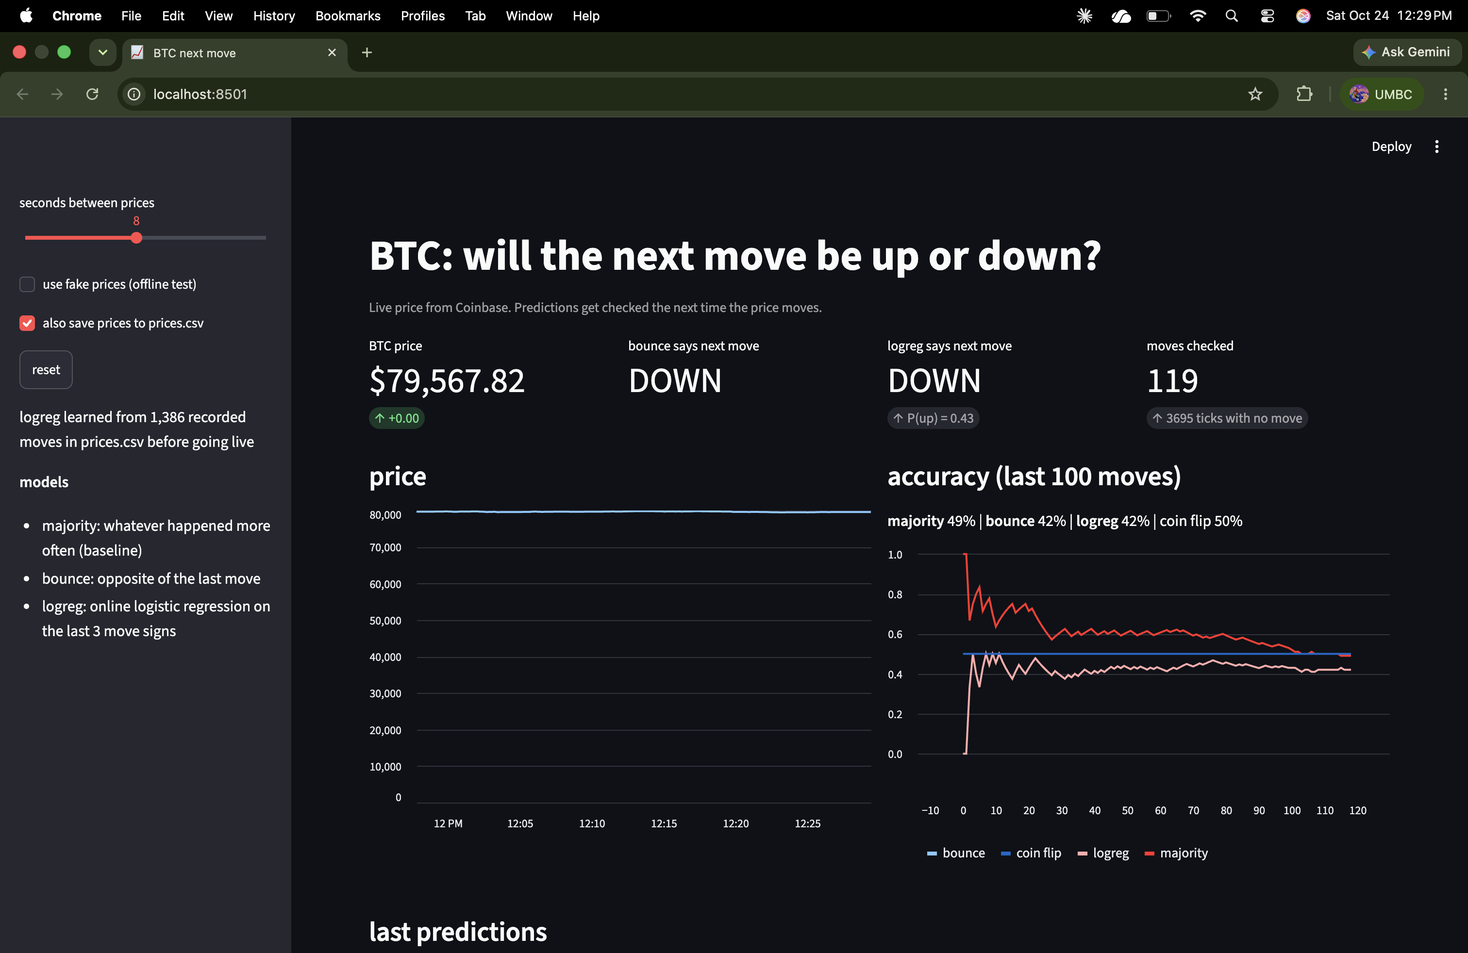
I put my BTC model in a web app
C · LIVE STREAMLIT APP · BTC NEXT MOVE
Every few seconds it gets the Coinbase price, checks the last predictions, learns, and predicts again.
In my realtime project the bounce rule got 66%. Live, at one price every 8 s:
42%
Worse than a coin flip.
First live run: ~30 min, 119 moves checked · streamlit run c_btc_app.py · practice dl · 08
Notes:
The logreg had learned bounce from my old prices.csv and just copied it, so it also got 42%. I also fixed two display bugs after this run: the price axis started at 0, and the no-move counter included the old file.

Slide 9
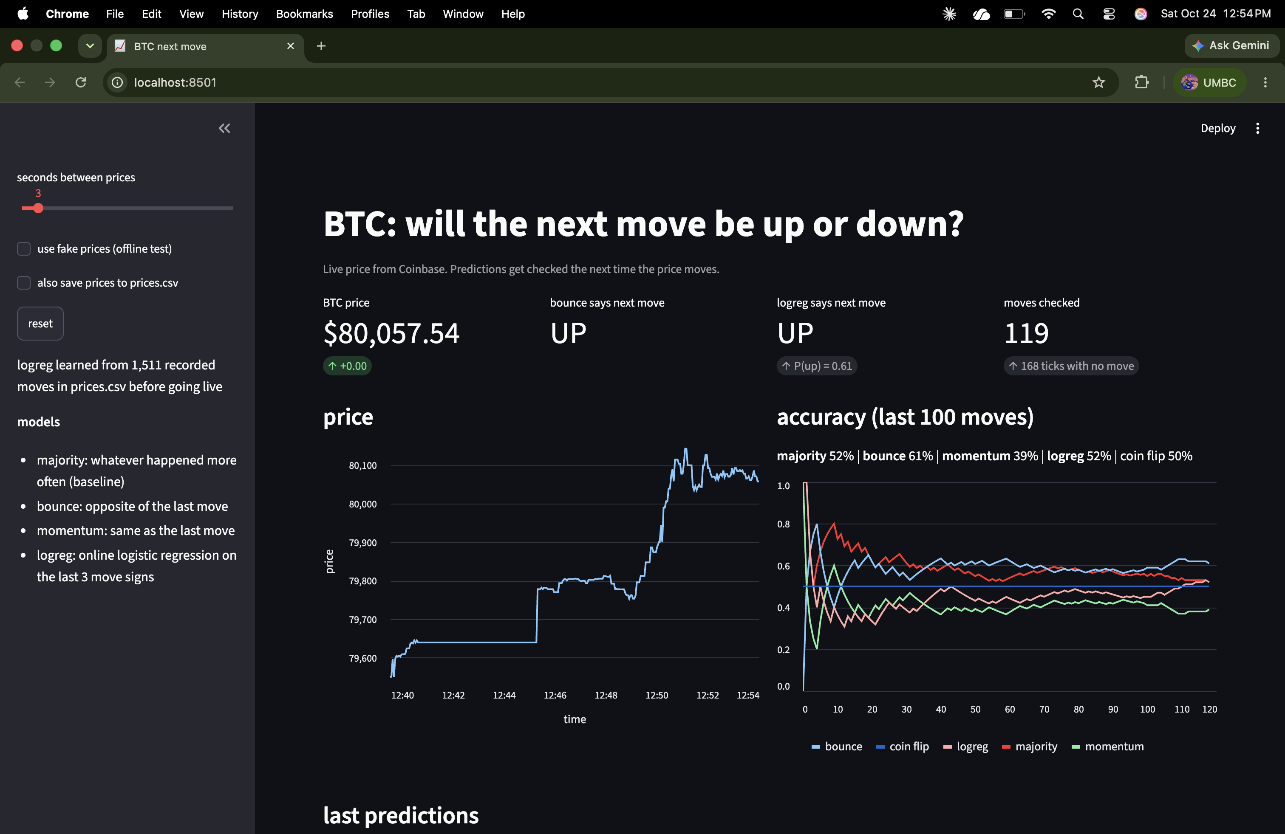
The pattern depends on how fast I sample
C · SECOND RUN · ONE PRICE EVERY 3 S
rule | 8 s | 3 s
bounce | 42% | 61%
momentum | – | 39%
majority | 49% | 52%
Sampled fast, the price flips between bid and ask, so “opposite of last move” works. At 8 s that’s gone. My “model” was really a model of how Coinbase quotes the price.
~15 min, 119 moves · a pattern from old data can stop working live (concept drift) · practice dl · 09
Notes:
I added a momentum rule (same as last move) so I could watch the mirror image of bounce. I also raised the logreg learning rate so it adapts, but then it kept changing its mind and only got 52%.

Slide 10
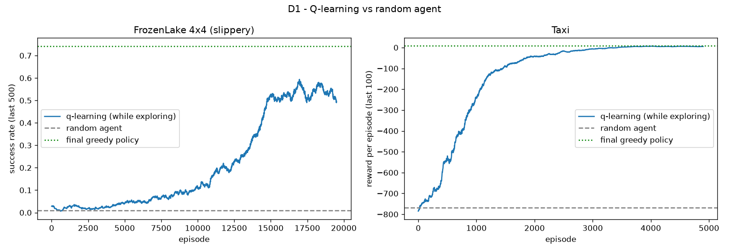
No dataset, just trial and reward
D1 · Q-LEARNING · FROZENLAKE + TAXI
game | random | Q-learning
FrozenLake (goal %) | 0.9% | 74.2%
Taxi (reward) | −767.7 | +7.9
On the start square it pushes into the wall. On slippery ice a slip then can’t send it into a hole. I wouldn’t have thought of that.
Tables of 16×4 and 500×6 values · trains in 2–3 s · practice dl · 10
Notes:
The training curve stays around 55% because it still takes a random action 5% of the time while learning, and one random step on the ice can drop you in a hole. The final greedy policy gets 74%.

Slide 11
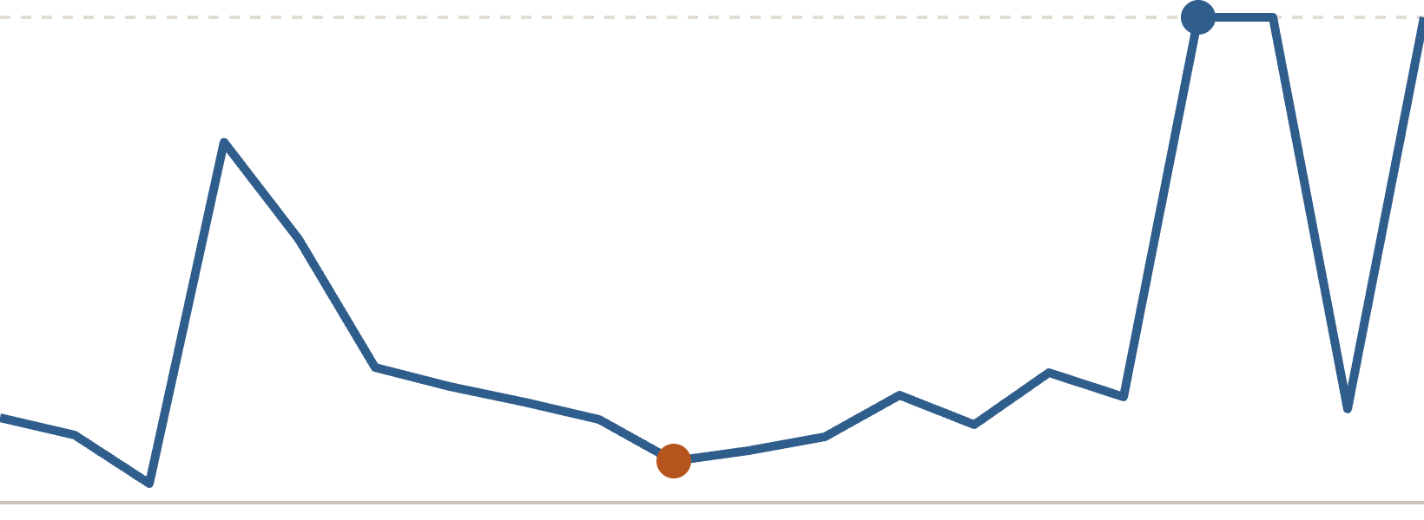
DQN got a perfect 500, but not smoothly
D2 · DQN · CARTPOLE
agent | avg steps
random pushes | 21.9
my 1-line physics rule | 500.0
Q-table with bins | 487.8
DQN (20 s on CPU) | 500.0
Greedy test score while training
DQN learned it from +1 rewards alone, without knowing any physics.
370 → 43 → 500 → 96 → 500. The net “forgets” as it trains, so I test every 20 episodes and keep the best version.
Net 4 → 128 → 128 → 2 · replay buffer + target network · 400 episodes · practice dl · 11
Notes:
First settings (explore for 10k steps, slow target network) got stuck around 300. Exploring for a shorter time and updating the target faster got to 500. Also honest point: CartPole is easy if you know the physics, my 1-line rule gets 500 too. The Q-table needs hand-picked bins and would explode with more state numbers, which is the real reason for a network.

Slide 12
Best model vs baseline in every step
ALL RESULTS
step | task | baseline | best
A1 | CIFAR-10 photos | MLP 51.7% | CNN 88.0%
A2 | CIFAR-10 photos | my CNN 88.0% | finetuned ResNet 95.2%
B1 | IMDB sentiment | word list 70.5% | logreg + pairs 90.6%
B2 | IMDB sentiment | B1 logreg 90.6% | avg embeddings 87.4%
B3 | IMDB sentiment | B1 logreg 90.6% | DistilBERT 91.8%
C | BTC next move, live | coin flip 50% | bounce 61% (3 s), 42% (8 s)
D1 | FrozenLake | random 0.9% | Q-learning 74.2%
D2 | CartPole | random 21.9 | DQN 500 (rule 500 too)
Bold = beat the baseline. B2 is the one step where nothing beat it · practice dl · 12
Notes:
Every number here comes from my own runs on the Mac, pasted from the terminal output.

Slide 13
What broke and how I fixed it
PROBLEMS I RAN INTO
No pip in my venv
IMDB download refused
GPU out of memory
“command not found: pip”, then “No module named pip”. Fixed with python -m ensurepip, and now I always use python -m pip.
Stanford’s server gave “Errno 61 Connection refused”. Switched to the same data on Hugging Face, Stanford as backup.
BiLSTM testing crashed with “MPS backend out of memory”. Smaller batches weren’t enough, so it now falls back to the CPU.
Running the old file
App bugs
Models stuck below baseline
Same crash again because I hadn’t saved the new version. The line number in the traceback gave it away.
Price chart started at 0 so BTC looked flat, and an old app was still on port 8501, so the new one opened on 8502.
DistilBERT first got 88.2% (fixed by reading the review ending). DQN first got stuck near 300 (fixed by tuning).
Also a VS Code “Extension activation failed” popup, which turned out to be harmless · practice dl · 13
Notes:
Lesson from these: don’t depend on one download link, check the traceback line numbers, and save before running.

Slide 14
Five things I’ll remember
WHAT I LEARNED
1
Pretrained models are worth a ton of data. ResNet on 2k photos ≈ my CNN on 45k. DistilBERT on 8k reviews beat logreg on 25k.
2
Simple baselines are hard to beat. Logreg beat both neural nets in B2. A 1-line rule balanced CartPole.
3
The data setup matters as much as the model. Review endings: 88.2% → 91.8%. Price interval: 61% → 42%.
4
Old patterns can stop working live. A deployed model has to keep checking its own accuracy.
5
Training is noisy, so keep the best checkpoint. DQN went 370 → 43 → 500. Validation saved me every time.
practice dl · 14

Slide 15
8 scripts, 4 topics, every model checked against a baseline.
PRACTICE DL · DONE
Code, results and the full list of problems are in my README. [next step: ______]
Notes:
Thanks for watching. All scripts are in the practice-dl folder with a requirements.txt, so anyone can run them.

